Slide 1
SPRINT PRESENTATION

Slide 2

How might we use virtual or augmented reality to create a more engaging
photo/video experience that motivates 18-24 year olds to upload more frequently?
Jasmine Oh, Lannie Miao, Samantha Haveson, Ziyan Yao

Slide 3
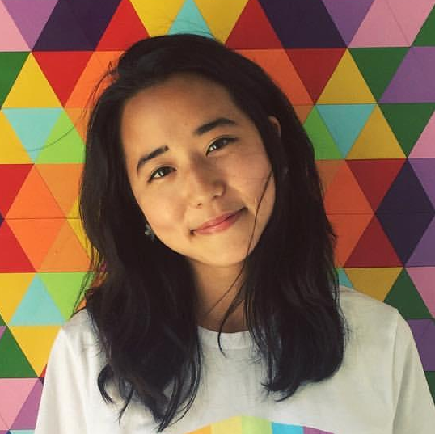
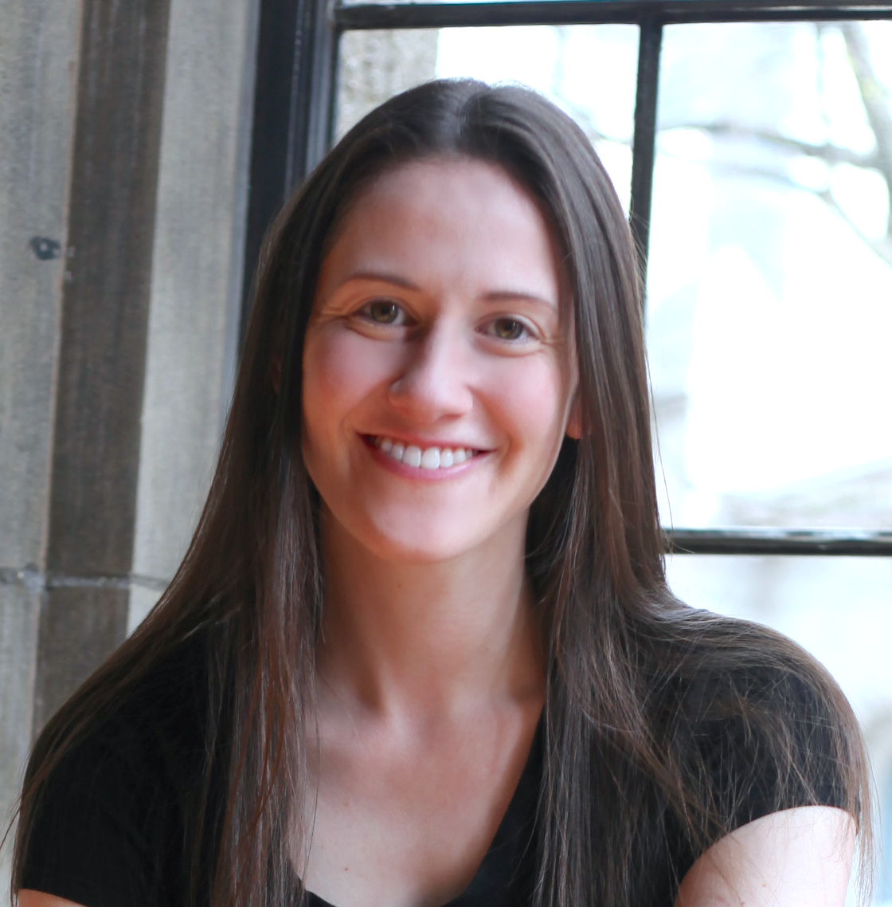
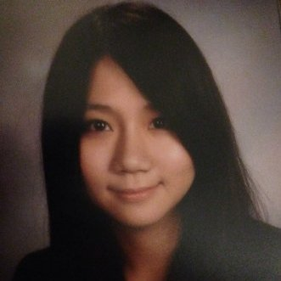
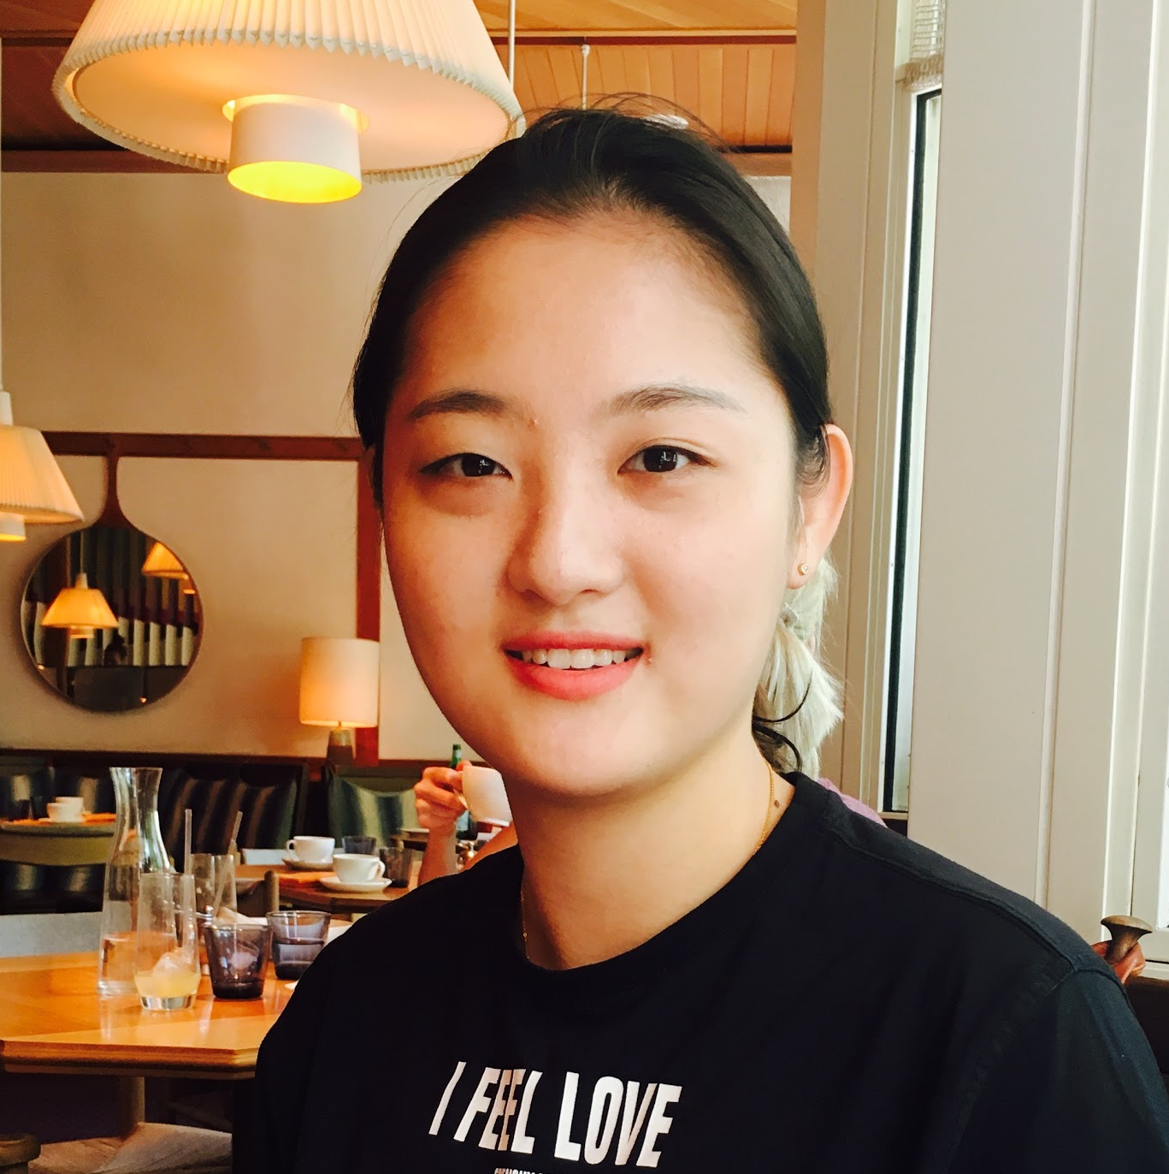
TEAM
Jasmine Oh
MFA
Parsons Design & Technology
Sam Haveson
MBA
Cornell Tech
Lannie Miao
Connective Media
Cornell Tech
Ziyan Yao
Computer Science
Cornell Tech

Slide 4
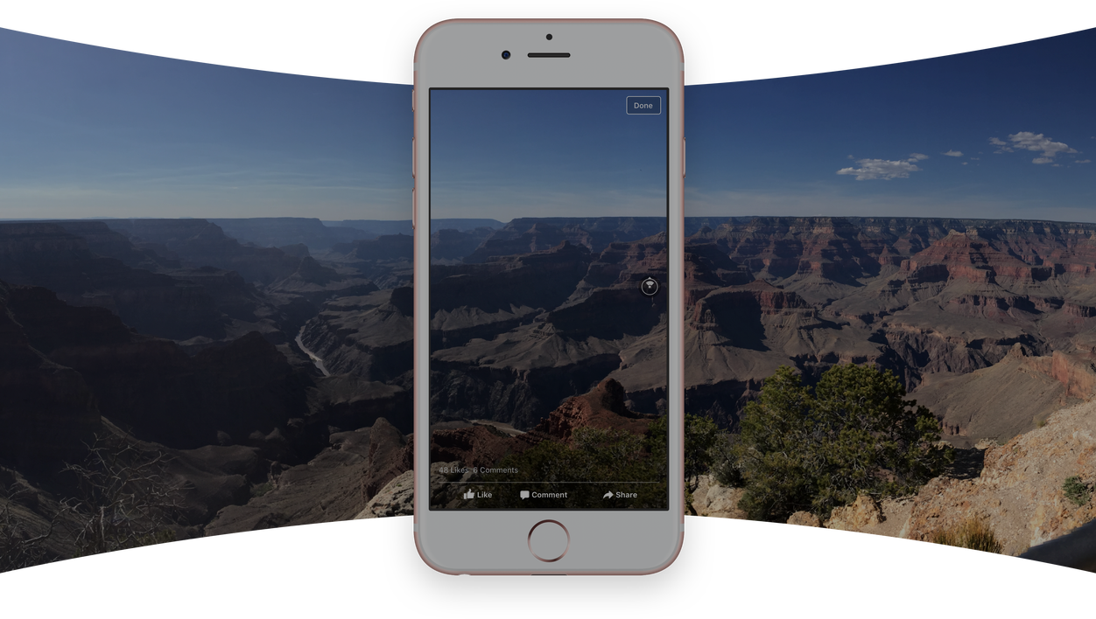
85% of 18-24 year olds who traveled in 2016 took a panorama photo
Notes:
- Google Survey Results

Slide 5

Meet Kate
Age: 21
Hometown: Arlington, VA
College: UCLA
Major: Fashion
”When I travel to New York for NYFW I love to take pictures and videos throughout my day. I try to capture everything , from the streets to fashion, so I can share the feelings and the whole environment with my friends back home.”
Notes:
This is not only Kate’s problem, but everyone else’s problem. (talk about the report by AARP on the millennial )
Reference- Google Nightwalk https://nightwalk.withgoogle.com/en/panorama/144
How do we help users know when to take 360 photos?
Some kind of activity. Browsing lots of content
When to launch the app
Call out the assumptions
Even if didn’t see all angles, who annotation
Sneak preview (thumbnail, visual indication)
Appreciate content without spending time, highlight
What would people get out of this? How do you feel?
connective , fun?
People take photos and videos in certain locations most albums turn into a collection of photos

Slide 6
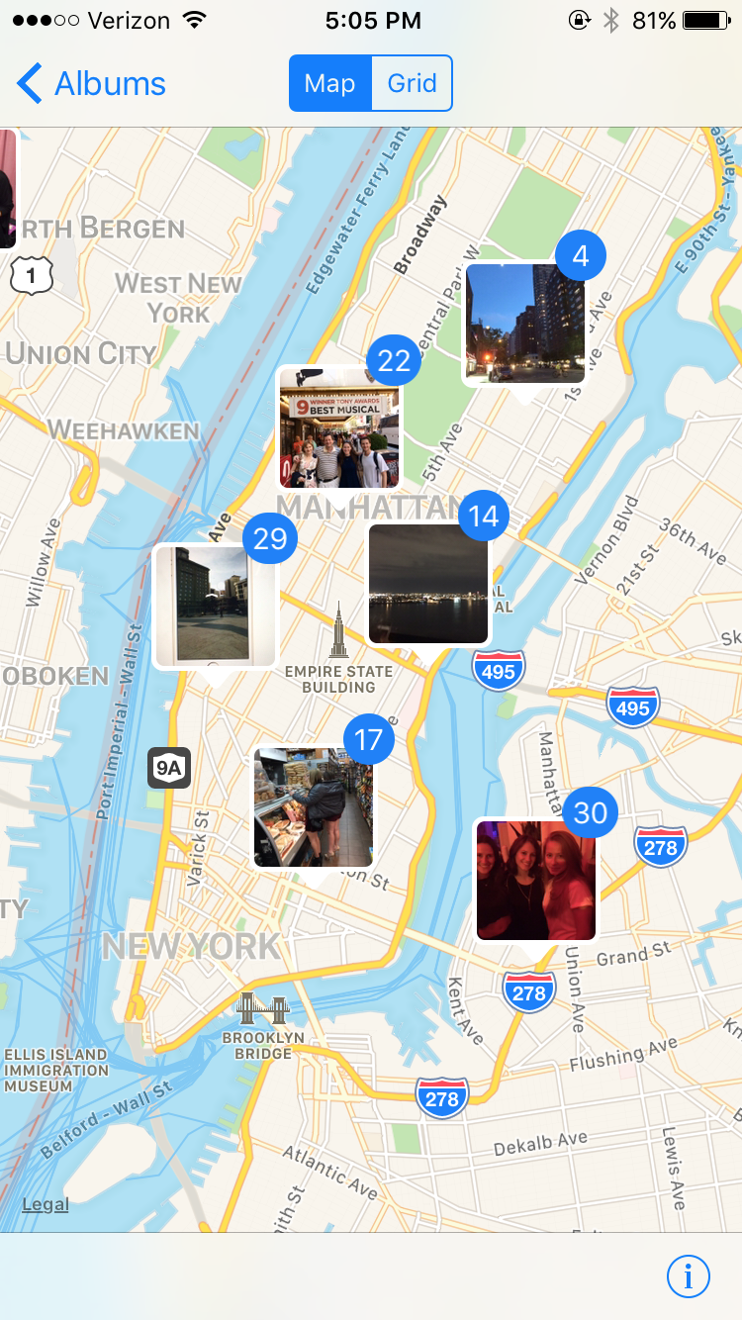
This experience is scattered.

Slide 7
NARRATIVE
Target audience
18-24 year olds who travel and capture photos and videos in new places.
Problem
Millennials are searching for creative ways to express themselves and their experiences. Photos are one dimensional and lack depth for capturing the whole environment. Solution
Amazon Drive enables users to take 360 photos and share their travel routes with personalized annotation, guiding others to virtually walk through their journeys in Google Streetview and see the photos they’ve taken.
Notes:
“Millennials are more likely than any other generations to be motivated by the desire to go on adventure.”
AARP 2016 Travel Trends

Slide 8
SYSTEM DIAGRAM & WEDGE
How might we provide the holistic experience to capture the journey?
How might we create 360 photos embedded with google street view?
Actors
Objects
Content
How
End Results
18-24 years old
Mobile phone
Journey
Take photo/video
Photo Storage
Photographer
Google Cardboard
Scenery
Save to drive
Capture the whole moment and share it with friends & family
Traveller
App
Special events
Upload 2nd photo/video from a different place
How might we highlight journey for viewers so that they don’t have to spend time browsing each single one?
College Students
AR/VR enabled equipments
Concert
Psychological stimulus
Fashion Blogger
Graduation
Select 3 photos and share journey
How might we bring VR experience to mobile rather than using headset?
Engage with viewers
International
Student
Food
Friends view the shared journey
Notes:
Based on our system diagram, we are mainly focusing on four wedges:
How might we bring VR experience to mobile?
How might we provide the holistic experience to capture the journey?
How might we create 360 photos embedded with google street view?
How might we highlight journey for viewers so that they don’t have to spend time browsing each single one?

Slide 9
Takes 360 photo using app
Experience the journey with creator’s photo & streetview photo on VR
Annotates journey (add audio, emoji, text, drawing)
Creator
Relive the journey with creator’s photo & Google streetview
Viewer
Picks travel route and shares journey
Receive
notification
Autosaved to Amazon Drive

Slide 10
DEMO
Notes:
https://invis.io/NB8PNQZVK

Slide 11
THANK YOU
Notes:
https://invis.io/NB8PNQZVK

